Slide 1



Software Architecture
Quality Attributes

Slide 2

The good software, like wine, takes time
Joel Spolsky
Trello Founder

Slide 3
Quality Attributes
Definitions

Slide 4
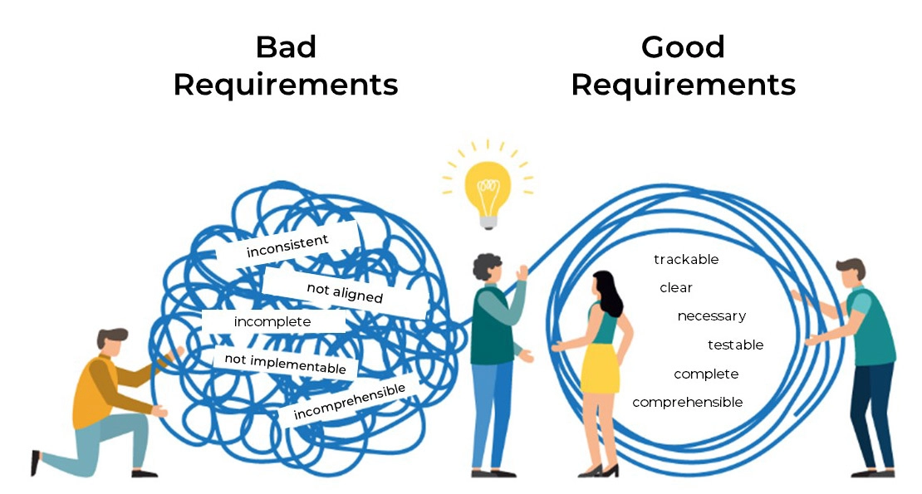
Requirements
Functional
Non Functional

Slide 5
Requirements
Functional Requirements
Functional requirements are product features or functions that developers must implement to enable users to perform their tasks.
Examples:
The system sends an approval request after the user enters personal information.
A search feature allows a user to hunt among various invoices if they want to credit an issued invoice.
The system sends a confirmation email when a new user account is created.
Notes:
Requisitos Funcionales
Los requisitos funcionales son características o funciones del producto que los desarrolladores deben implementar para que los usuarios puedan realizar sus tareas. Por lo tanto, es importante aclararlos tanto al equipo de desarrollo como a las partes interesadas. Generalmente, los requisitos funcionales describen el comportamiento del sistema en condiciones específicas.
Ejemplos:
El sistema envía una solicitud de aprobación después de que el usuario ingresa su información personal.
Una función de búsqueda permite al usuario buscar entre varias facturas si desea abonar una factura emitida.
El sistema envía un correo electrónico de confirmación al crear una nueva cuenta de usuario.

Slide 6
Quality Attributes
Non-Functional Requirements
Non-functional requirements (NFRs) define the criteria that are used to evaluate the whole system, but not for a specific behavior, and are also called quality attributes and described in detail in architectural specifications.
All NFRs can be divided into two main categories:
NFRs that affect system behavior, design, and user interface during work.
NFRs that affect the development and support of the system.
Examples:
The website pages should load in 3 seconds with the total number of simultaneous users <5 thousand.
The system should be able to handle 20 million users without performance deterioration.
Notes:
Requisitos No Funcionales
Los requisitos no funcionales (NFR) definen los criterios utilizados para evaluar el sistema en su conjunto, pero no un comportamiento específico. También se denominan atributos de calidad y se describen en detalle en las especificaciones de arquitectura.
Todos los NFR se pueden dividir en dos categorías principales:
NFR que afectan el comportamiento, el diseño y la interfaz de usuario del sistema durante el funcionamiento.
NFR que afectan el desarrollo y el soporte del sistema.
Ejemplos:
Las páginas del sitio web deben cargar en 3 segundos con un número total de usuarios simultáneos inferior a 5000.
El sistema debe ser capaz de gestionar 20 millones de usuarios sin que se vea afectado su rendimiento.

Slide 7
Quality Attributes
Functional vs Non-Functional Requirements
Category | Functional Requirements | Non-Functinal Requirements
Objective | Describe what the product does | Describe how the product works
End Result | Define product features | Define product Properties
Focus | Focus on user requirements | Focus on user expectations
Documentation | Captured in use case | Captured as a quality attribute
Essentiality | They are mandatory | They are not mandatory but desireable
Origin Type | Usually defined by user | Usually defined by developers or other tech expert
Testing | Componen, API, UI Testing, etc. Tested before nonfunctional testing | Performance, usuability, security testing, etc. Tested after functional testing
Types | External Interface, authetication, authorization levels, business rules, etc. | Usability, reliability, scalability, performance, etc.
Notes:
| Categoría | Requisitos funcionales | Requisitos no funcionales |
|--------------------------|------------------------------------------------------|----------------------------------------------------------|
| Objetivo | Describir qué hace el producto | Describir cómo funciona el producto |
| | | |
| Resultado final | Definir las características del producto | Definir las propiedades del producto |
| | | |
| Enfoque | Centrarse en los requisitos del usuario | Centrarse en las expectativas del usuario |
| | | |
| Documentación | Capturado en el caso de uso | Capturado como un atributo de calidad |
| | | |
| Esencialidad | Son obligatorios | No son obligatorios, pero deseables |
| | | |
| Tipo de origen | Generalmente definido por el usuario | Generalmente definido por los desarrolladores u |
| | | otro experto técnico |
| | | |
| Pruebas | Pruebas de componentes, API, IU, etc. | Pruebas de rendimiento, usabilidad, seguridad, etc. |
| | Probado antes de las pruebas no funcionales | Probado después de las pruebas funcionales |
| | | |
| Tipos | Interfaz externa, autenticación | Usabilidad, fiabilidad, escalabilidad |
| | Niveles de autorización, reglas de negocio, etc. | Rendimiento, etc. |

Slide 8
Quality Attributes
Definitions
A Quality Attribute is a property of a software system that determines its usefulness and success from the client and business standpoint.
A quality attribute acts as the driver for a software system.
But are there any software systems without QA defined?
Notes:
Un atributo de calidad es una propiedad de un sistema de software que determina su utilidad y éxito desde la perspectiva del cliente y del negocio. Por ejemplo, si un sistema de contabilidad está diseñado con excelencia técnica, pero es difícil de usar, carece de soporte técnico y requiere un largo tiempo para la comercialización de nuevas funciones, es probable que fracase a largo plazo.
Un atributo de calidad actúa como el motor de un sistema de software. Define las restricciones y los objetivos que deben cumplir la arquitectura del sistema, el proceso de desarrollo y todo el Ciclo de Vida del Desarrollo de Software (SDLC); de lo contrario, el equipo responsable de una aplicación podría verse desorientado.
Pero ¿existen sistemas de software sin un control de calidad definido?
La respuesta corta es no. La respuesta larga es que existen dos tipos de sistemas: el primero, con atributos de calidad bien definidos y conocidos que impulsan decisiones técnicas informadas, y el segundo, con todos los demás sistemas. Este artículo ofrece ejemplos de ambos en secciones posteriores.

Slide 9
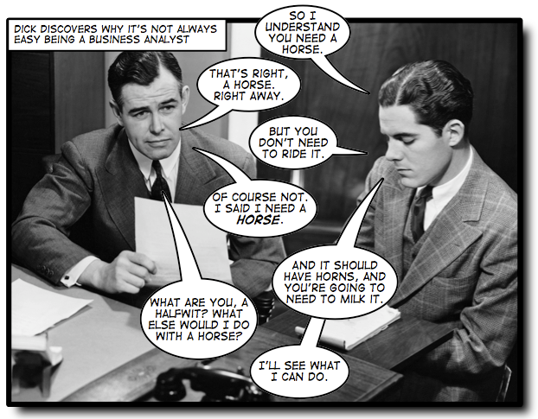
Quality Attributes
The customer will never know what he wants, but he will always know what he does not want.
Notes:
El cliente nunca sabrá lo que quiere, pero siempre sabrá lo que no quiere.

Slide 10
Quality Attributes
Classifications

Slide 11
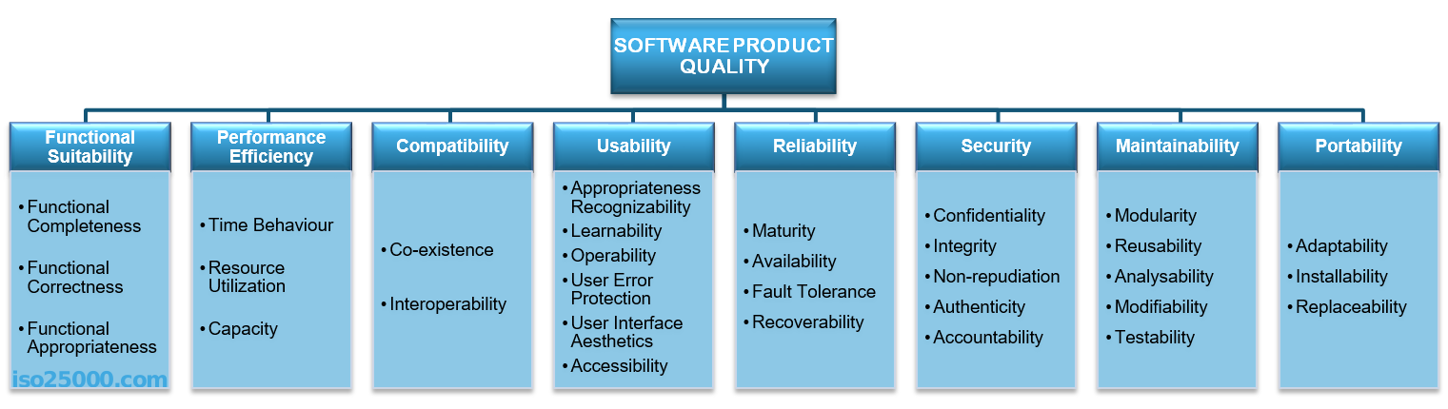
Quality Attributes
ISO/IEC 25010

Slide 12
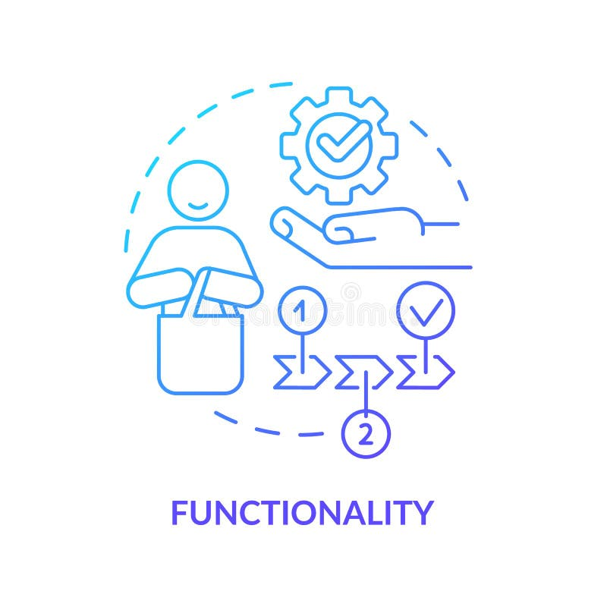
Quality Attributes
Functional Suitability
This characteristic represents the degree to which a product or system provides functions that meet stated and implied needs when used under specified conditions.
Functional completeness
Functional correctness
Functional appropriateness
Notes:
Adecuación Funcional
Esta característica representa el grado en que un producto o sistema proporciona funciones que satisfacen las necesidades declaradas e implícitas cuando se utiliza en condiciones específicas. Esta característica se compone de las siguientes subcaracterísticas:
Completitud funcional: Grado en que el conjunto de funciones cubre todas las tareas y objetivos del usuario especificados.
Corrección funcional: Grado en que un producto o sistema proporciona los resultados correctos con la precisión necesaria.
Idoneidad funcional: Grado en que las funciones facilitan el cumplimiento de las tareas y objetivos especificados.
https://iso25000.com/index.php/en/iso-25000-standards/iso-25010

Slide 13

Quality Attributes
Performance
Performance shows the response of the system to performing certain actions for a certain period.
Measures:
Latency
Channel Capacity
Indicators
Average/Maximum Number of XXX
Average page load time
Average method execution time
Notes:
Eficiencia del rendimiento
Esta característica representa el rendimiento en relación con la cantidad de recursos utilizados en las condiciones establecidas. Esta característica se compone de las siguientes subcaracterísticas:
Comportamiento temporal: Grado en que los tiempos de respuesta y procesamiento, así como las tasas de rendimiento de un producto o sistema, al realizar sus funciones, cumplen con los requisitos.
Utilización de recursos: Grado en que la cantidad y los tipos de recursos utilizados por un producto o sistema, al realizar sus funciones, cumplen con los requisitos.
Capacidad: Grado en que los límites máximos de un parámetro del producto o sistema cumplen con los requisitos.
https://iso25000.com/index.php/en/iso-25000-standards/iso-25010
Rendimiento
muestra la respuesta del sistema al realizar ciertas acciones durante un período determinado.
Hay dos maneras de medir el rendimiento:
Latencia: Tiempo empleado en responder a un evento
Capacidad del canal: El número de eventos que ocurren en un momento determinado.
En la práctica, los posibles indicadores de rendimiento incluyen, por ejemplo:
Número promedio/máximo de usuarios del sistema por unidad de tiempo.
Tiempo promedio de carga de página.
Tiempo promedio de ejecución de métodos.
Los problemas de rendimiento a menudo se convierten en problemas que pueden afectar todo, desde la capacidad del servidor o el desarrollo del frontend hasta la eficiencia de las consultas a la base de datos o la capacidad de los canales de comunicación.
El rendimiento casi siempre se incluye en la lista de atributos de calidad críticos que el arquitecto debe considerar, ya que afecta a todo el sistema y puede afectar a muchas partes de la solución arquitectónica. Por lo tanto, en internet puede encontrar una gran cantidad de ejemplos de cómo abordar los problemas de rendimiento.
https://medium.com/@nvashanin/quality-attributes-in-software-architecture-3844ea482732

Slide 14

Quality Attributes
Compatibility/Interoperability
Is an attribute of the system or part of the system that is responsible for its operation and the transmission of data and its exchange with other external systems.
Problems:
Outdated external systems.
Different formats of data in similar external systems.
Different versions of the API in external systems.
Backward compatibility of the API for integration.
Poor quality and lack of standards of external systems.
In the Best Case, API to interact with different layers, in the worst Rebuild the system.
Notes:
Compatibility
Degree to which a product, system or component can exchange information with other products, systems or components, and/or perform its required functions while sharing the same hardware or software environment. This characteristic is composed of the following sub-characteristics:
Co-existence - Degree to which a product can perform its required functions efficiently while sharing a common environment and resources with other products, without detrimental impact on any other product.
Interoperability - Degree to which two or more systems, products or components can exchange information and use the information that has been exchanged.
https://iso25000.com/index.php/en/iso-25000-standards/iso-25010?start=3
Interoperability is an attribute of the system or part of the system that is responsible for its operation and the transmission of data and its exchange with other external systems. A well-designed system facilitates integration with third-party systems. To improve the interoperability, you can use well-designed external interfaces, standardization systems, etc.
Naturally, there are a lot of problems for interaction:
Outdated external systems.
Different formats of data in similar external systems.
Different versions of the API in external systems.
Backward compatibility of the API for integration.
Poor quality and lack of standards of external systems.
Interoperability cannot be ignored. In the best case, you will have to create additional layers for the interaction API. At worst, it will be necessary to rebuild the entire system.
https://medium.com/@nvashanin/quality-attributes-in-software-architecture-3844ea482732
Interoperability is an attribute of the system or part of the system that is responsible for its operation and the transmission of data and its exchange with other external systems. A well-designed system facilitates integration with third-party systems. To improve the interoperability, you can use well-designed external interfaces, standardization systems, etc.
Naturally, there are a lot of problems for interaction:
Outdated external systems.
Different formats of data in similar external systems.
Different versions of the API in external systems.
Backward compatibility of the API for integration.
Poor quality and lack of standards of external systems.
Interoperability cannot be ignored. In the best case, you will have to create additional layers for the interaction API. At worst, it will be necessary to rebuild the entire system.

Slide 15
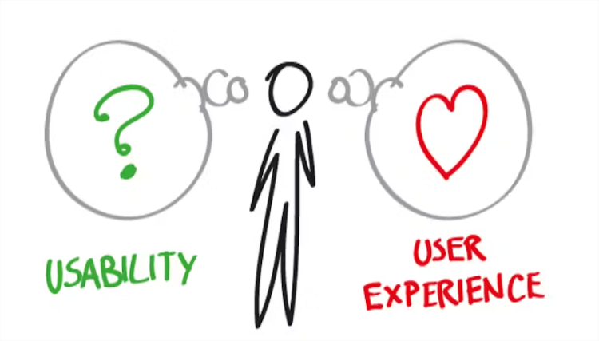
Quality Attributes
Usability
The degree to which a product or system can be used by specified users to achieve specified goals with effectiveness, efficiency, and satisfaction in a specified context of use. Easy to use.
Characteristics
Simple & Intuitive Design
Learnability
Usage Efficiency
Memorability
Error Frequency and Severity
Subjective Fulfillment
Notes:
Usability
Degree to which a product or system can be used by specified users to achieve specified goals with effectiveness, efficiency and satisfaction in a specified context of use. This characteristic is composed of the following sub-characteristics:
Appropriateness recognizability - Degree to which users can recognize whether a product or system is appropriate for their needs.
Learnability - Degree to which a product or system can be used by specified users to achieve specified goals of learning to use the product or system with effectiveness, efficiency, freedom from risk and satisfaction in a specified context of use.
Operability - Degree to which a product or system has attributes that make it easy to operate and control.
User error protection. Degree to which a system protects users against making errors.
User interface aesthetics - Degree to which a user interface enables pleasing and satisfying interaction for the user.
Accessibility - Degree to which a product or system can be used by people with the widest range of characteristics and capabilities to achieve a specified goal in a specified context of use.
https://iso25000.com/index.php/en/iso-25000-standards/iso-25010?start=3
Usability
is one of the most essential attributes, because, unlike in cases with other attributes, users can see directly how well this attribute of the system is worked out. One of the critical problems of usability is too much interaction or too many actions necessary to accomplish a task. Incorrect sequences of steps in multistage interfaces are also a problem of usability. Data elements and controls may be designed not according to the accepted patterns of user experience, which also complicates the interaction. For example, if you are developing an iOS application, then it is important to use the guidelines from Apple, or the guidelines from Microsoft — for Windows desktop applications.
Examples of important indicators for this attribute are:
List of supported devices, OS versions, screen resolutions, and browsers and their versions.
Elements that accelerate user interaction, such as “hotkeys,” “lists of suggestions,” and so on.
The average time a user needs to perform individual actions.
Support of accessibility for people with disabilities.
https://medium.com/@nvashanin/quality-attributes-in-software-architecture-3844ea482732
#3) Usability
This attribute refers to the quality of the end user’s experience while interacting with the application or service. Usability is concerned with effectiveness, efficiency, and overall user satisfaction.
This attribute helps to measure the ease of use of any software application or service (e.g., registering a new account and then signing in to the account)
A few of the following problems can arise if usability is not taken care of correctly:
Complex sign-up process
Inconsistency in UI
Unclear navigation and at times complicated.
Error messages not user friendly
Sub-attributes for usability are listed below:
Simple & Intuitive Design: It describes the user’s ability to effortlessly understand the design of the application and navigate without any conscious reasoning.
Learnability: It refers to the ease and speed with which a user who has never seen the user interface before can execute the most basic tasks.
Usage Efficiency: It means how fast a user can accomplish tasks once he/she gets an experience of the system.
Memorability: It describes how well a user can use an application (site) effectively, after not using it for a while.
Error Frequency and Severity: It refers to how frequently users make mistakes while using the system, how serious the errors are, and how users recover from these errors.
Subjective Fulfillment: It describes how well the system is liked by the user.
Example: A web application for scientists and research students had all of the necessary features, however, some of the sub-menus on one or more pages were concealed (for instance, they were only seen after clicking the ellipsis button). As a result, users had a tough time understanding how to start using those features.
Possible Check: As far as possible, UI design should be maintained as simple, intuitive, and from the end user’s perspective. An adequate quantity of usability testing should be performed.
https://www.softwaretestinghelp.com/what-are-the-quality-attributes/

Slide 16
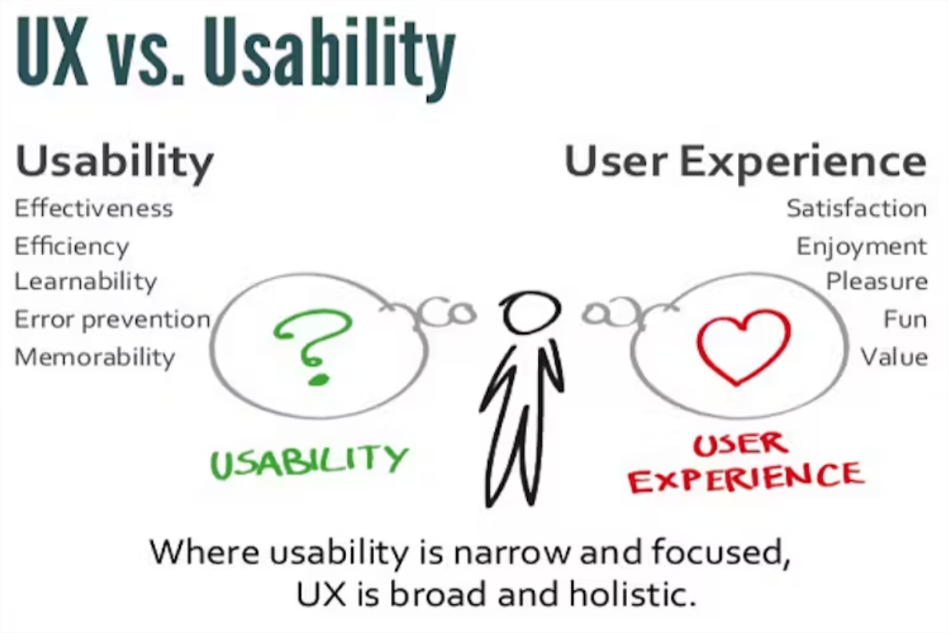
Quality Attributes
Notes:
https://hackernoon.com/the-ultimate-guide-difference-between-usability-and-user-experience-e926c11eac7a/

Slide 17

Quality Attributes
Reliability
Is an attribute of the system responsible for the ability to continue to operate under predefined conditions. Most often, the system fails due to the inaccessibility of external elements, such as databases, systems, and network connections.
Characteristics
Maturity
Availability
Fault tolerance
Recoverability
Notes:
Reliability
Degree to which a system, product or component performs specified functions under specified conditions for a specified period of time. This characteristic is composed of the following sub-characteristics:
Maturity - Degree to which a system, product or component meets needs for reliability under normal operation.
Availability - Degree to which a system, product or component is operational and accessible when required for use.
Fault tolerance - Degree to which a system, product or component operates as intended despite the presence of hardware or software faults.
Recoverability - Degree to which, in the event of an interruption or a failure, a product or system can recover the data directly affected and re-establish the desired state of the system.
https://iso25000.com/index.php/en/iso-25000-standards/iso-25010?start=3
Reliability
is an attribute of the system responsible for the ability to continue to operate under predefined conditions. Most often, the system fails due to the inaccessibility of external elements, such as databases, systems, and network connections.
https://medium.com/@nvashanin/quality-attributes-in-software-architecture-3844ea482732

Slide 18
Quality Attributes
Availability Levels
Availability level | Allowed unavailability window
(uptime) | per year | per quarter | per month | per week | per day | per hour
90% | 36.5 days | 9 days | 3 days | 16.8 hours | 2.4 hours | 6 minutes
95% | 18.25 days | 4.5 days | 1.5 days | 8.4 hours | 1.2 hours | 3 minutes
99% | 3.65 days | 21.6 hours | 7.2 hours | 1.68 hours | 14.4 minutes | 36 seconds
99.5% | 1.83 days | 10.8 hours | 3.6 hours | 50.4 minutes | 7.20 minutes | 18 seconds
99.9% | 8.76 hours | 2.16 hours | 43.2 minutes | 10.1 minutes | 1.44 minutes | 3.6 seconds
99.95% | 4.38 hours | 1.08 hours | 21.6 minutes | 5.04 minutes | 43.2 seconds | 1.8 seconds
99.99% | 52.6 minutes | 12.96 minutes | 4.32 minutes | 60.5 seconds | 8.64 seconds | 0.36 seconds
99.999% | 5.26 minutes | 1.30 minutes | 25.9 seconds | 6.05 seconds | 0.87 seconds | 0.04 seconds
Notes:
https://betterstack.com/community/guides/incident-management/availability-table/
https://en.wikipedia.org/wiki/High_availability
Agreed SLA level
https://uptime.is/
Calculate Avaiability Percentage
https://www.fiixsoftware.com/glossary/system-availability/

Slide 19

Quality Attributes
Security
Security is responsible for the ability of the system to reduce the likelihood of malicious or accidental actions as well as the possibility of theft or loss of information. Several measures are used to protect systems: authentication, encryption, audit, and others.
Characteristics
Confidentiality
Integrity
Non-repudiation
Accountability
Authenticity
Notes:
Security
Degree to which a product or system protects information and data so that persons or other products or systems have the degree of data access appropriate to their types and levels of authorization. This characteristic is composed of the following sub-characteristics:
Confidentiality - Degree to which a product or system ensures that data are accessible only to those authorized to have access.
Integrity - Degree to which a system, product or component prevents unauthorized access to, or modification of, computer programs or data.
Non-repudiation - Degree to which actions or events can be proven to have taken place so that the events or actions cannot be repudiated later.
Accountability - Degree to which the actions of an entity can be traced uniquely to the entity.
Authenticity - Degree to which the identity of a subject or resource can be proved to be the one claimed.
https://iso25000.com/index.php/en/iso-25000-standards/iso-25010?start=6
Security
Is responsible for the ability of the system to reduce the likelihood of malicious or accidental actions as well as the possibility of theft or loss of information. Several measures are used to protect systems: authentication, encryption, audit, and others.
Examples of this attribute in the work of the system are:
The ability of the system to detect DDoS attacks and respond to them.
Restrictions of user access by authentication/authorization.
Prevention of SQL injection.
Encryption of passwords and content.
Secure connection.
https://medium.com/@nvashanin/quality-attributes-in-software-architecture-3844ea482732

Slide 20

Quality Attributes
Maintainability
Is the ability of the system to support changes. Changes can be related to new business requirements or the correction of old errors and affect system components or separate methods.
Characteristics
Modularity
Reusability
Analysability
Modifiability
Testability
Notes:
Maintainability
This characteristic represents the degree of effectiveness and efficiency with which a product or system can be modified to improve it, correct it or adapt it to changes in environment, and in requirements. This characteristic is composed of the following sub-characteristics:
Modularity - Degree to which a system or computer program is composed of discrete components such that a change to one component has minimal impact on other components.
Reusability - Degree to which an asset can be used in more than one system, or in building other assets.
Analysability - Degree of effectiveness and efficiency with which it is possible to assess the impact on a product or system of an intended change to one or more of its parts, or to diagnose a product for deficiencies or causes of failures, or to identify parts to be modified.
Modifiability - Degree to which a product or system can be effectively and efficiently modified without introducing defects or degrading existing product quality.
Testability - Degree of effectiveness and efficiency with which test criteria can be established for a system, product or component and tests can be performed to determine whether those criteria have been met.
https://iso25000.com/index.php/en/iso-25000-standards/iso-25010?start=6
Maintainability is the ability of the system to support changes. Changes can be related to new business requirements or the correction of old errors and affect system components or separate methods. Also, maintainability affects the time needed to restore the system after a failure. Excessive dependencies between components have a very negative effect on maintainability. In programming, there is a notion of anti-pattern spaghetti code, which means excessive coherence in the code. In architecture, there is no such thing, but architecture is very close to programming in this sense. It is because of the maintainability attribute that such concepts as separation of responsibility, microservice architectures, and modularity have appeared. At the same time, this attribute affects not only development processes but also management processes (for example, splitting teams into product-related parts).
https://medium.com/@nvashanin/quality-attributes-in-software-architecture-3844ea482732
#2) Maintainability
It is the ease with which a software developer is able to fix flaws in the existing functionality without impacting other components of the software system. It also considers the ease with which a developer can add new features, update existing features or upgrade the system with new technology.
Software maintainability is achieved through adherence to software architectural rules and consistency across the application.
The purpose of having this attribute is to make the maintenance of software applications easy and cost-effective.
The software industry typically uses some of the following common maintenance types:
Corrective: This is the most essential type, where in developer(s) analyses the detected bug and implements a fix for it.
Adaptive: In this case, the application might be migrated for the use of a different database or technology (e.g. MS SQL to PostgreSQL; from C++ to C#).
Preventive: Preventive bugs or failures might be a very difficult task. But by implementing proper coding standards, documenting code, avoiding complex code, and doing enough testing, certainly errors can be reduced.
Perfective: This could involve code refactoring. The idea is to improve the existing code and thereby the feature/functionality.
Example: Due to the intricate nature of the code, implementing a new GDPR in the legacy product (running for more than 20 years) was a true headache for the developers.
Possible check: Software developer(s) should write the code as simple as possible and add comments in the code (in-line or block comments) wherever necessary.
https://www.softwaretestinghelp.com/what-are-the-quality-attributes/

Slide 21

Quality Attributes
Portability
It refers to the extent to which a system or its components can be migrated (transported) to other environments consisting of different hardware and/or different software (operating system).
Characteristics
Adaptability
Installability
Replaceability
Notes:
Portability
Degree of effectiveness and efficiency with which a system, product or component can be transferred from one hardware, software or other operational or usage environment to another. This characteristic is composed of the following sub-characteristics:
Adaptability - Degree to which a product or system can effectively and efficiently be adapted for different or evolving hardware, software or other operational or usage environments.
Installability - Degree of effectiveness and efficiency with which a product or system can be successfully installed and/or uninstalled in a specified environment.
Replaceability - Degree to which a product can replace another specified software product for the same purpose in the same environment.
https://iso25000.com/index.php/en/iso-25000-standards/iso-25010?start=6
#4) Portability
It refers to the extent to which a system or its components can be migrated (transported) to other environments consisting of different hardware and/or different software (operating system). The importance of software portability should not be underestimated.
Sub-attributes for portability are listed below:
Adaptability: It refers to how easily a software system can be adapted to new hardware, software, or another environment.
Replaceability: It refers to how effectively one software product can replace another software solution designed for the same purpose. It is the capability of one software component to be replaced by another one.
Installability: It specifies the ease with which a software solution can be installed or uninstalled in a given environment.
Compatibility (Co-existence): It is the degree to which multiple, unrelated software systems and/or components co-exist in the same environment.
[image source]
Example: Mobile version of event booking software was working fine on Android but had issues with context menus on iOS (iPhone as well as iPad)
Possible Check: During the development phase, software portability should be given careful consideration. There should be a clear and generalized abstraction between business logic and system interfaces. CSS/styling should be implemented with diverse OS platforms in mind, for example, Portability testing should be given enough importance.
https://www.softwaretestinghelp.com/what-are-the-quality-attributes/

Slide 22


Quality Attributes

Slide 23

Quality Attributes
Quiz

Slide 24
Quality Attributes
The Functional requirements are product features or functions that developers must implement to enable users to perform their tasks.
True
Non-functional requirements (NFRs) define the criteria that are used to evaluate the system, for a specific behavior.
False: Not for a specific behavior, is for whole system specification
The Non-Functional requirements described in detail the architectural specifications.
True
The Non-Functional requirements Describe how the product works
True
The Functional requirements Define product Properties
False: Define product features

Slide 25
Quality Attributes
A Quality Attribute is a feature of a software system that defines a business standpoint.
False : determines its usefulness and success from the client not only de business or commercial standpoint
The mainly quality attribute categories are: Functional Suitability, Performance, Compatibility, Usability, Reliability, Security, Maintainability, Portability
True
The quality attributes define the architecture drivers for a whole system
True

Slide 26
Knowledge
Practice

Slide 27

Quality Attributes
Write Overview Project
Extract the Functional Requirements
Extract the Non-Functional Requirements
Identify the Quality Attributes
Classify and score them

Slide 28


